Slide 1
BITS Pilani
Dr. Lavika Goel
Assistant Professor
Department of CSIS
Lecture 11: 13/4/2019
Pilani Campus

Slide 2
Pilani Campus
RECOMMENDER SYSTEMS

Slide 3
Today’s Agenda
Collaborative Filtering
Model based approaches for recommender systems
Netflix competition
Latent factors
4/12/2019 SS ZG537 (INFORMATION RETRIEVAL) 3
Pilani Campus

Slide 4
From Search to Recommendation
“The Web is leaving the era of search and entering one of discovery. What's the difference?
Search is what you do when you're looking for something.
Discovery is when something wonderful that you didn't know existed, or didn't know how to ask for, finds you.” –CNN Money, “The race to create a 'smart' Google.
4/12/2019 SS ZG537 (INFORMATION RETRIEVAL) 4
Pilani Campus

Slide 5
The value of recommendations
Netflix: 2/3 of the movies watched are recommended
Google News: recommendations generate 38% more click-throughs
Amazon: 35% sales from recommendations
Choicestream: 28% of the people would buy more music if they found what they liked.
4/12/2019 SS ZG537 (INFORMATION RETRIEVAL) 5
Pilani Campus

Slide 6
The “Recommender problem”
Estimate a utility function to predict how a user
will like an item.
Given data on the activity of a set of users, provide personalized
recommendations to users X, Y, Z,. . .
4/12/2019 SS ZG537 (INFORMATION RETRIEVAL) 6
Pilani Campus

Slide 7
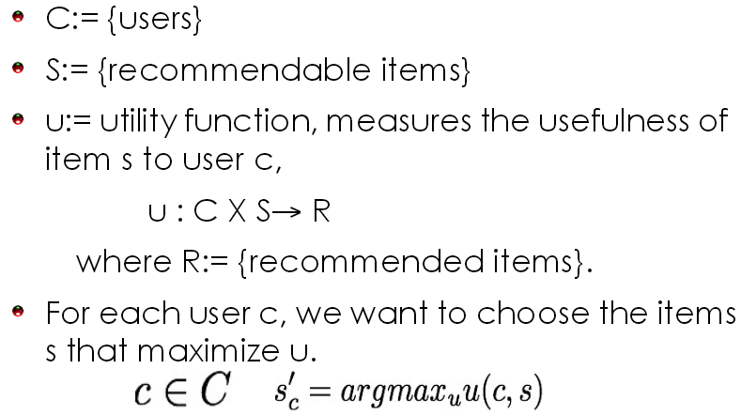
The “Recommender problem”
4/12/2019 SS ZG537 (INFORMATION RETRIEVAL) 7
Pilani Campus

Slide 8
A good recommendation
Is relevant to the user: personalized
Is diverse: it represents all the possible interests of one user
Does not recommend items the user already knows or would have found anyway.
Expands the user's taste into neighboring areas.
4/12/2019 SS ZG537 (INFORMATION RETRIEVAL) 8
Pilani Campus

Slide 9
What works?
Depends on the domain and particular problem
Currently, the best approach is Collaborative Filtering.
Other approaches can be combined to improve results
What matters?
Data preprocessing: outlier removal, denoising, removal of global effects
“Smart” dimensionality reduction
Combining methods
4/12/2019 SS ZG537 (INFORMATION RETRIEVAL) 9
Pilani Campus

Slide 10
Collaborative Filtering
The task of predicting (filtering) user preferences on new items by collecting taste information from many users (collaborative).
Challenges:
Many items to choose from
very few recommendations to propose
few data per user
no data for new user
very large datasets
Examples of its use include Amazon, iTunes, Netflix, LastFM, StumbleUpon, and Delicious.
4/12/2019 SS ZG537 (INFORMATION RETRIEVAL) 10
Pilani Campus

Slide 11
Algorithms
User-based nearest neighbor
Non-probabilistic Algorithms
Item-based nearest neighbor
Collaborative Filtering
Reducing dimensionality
Bayesian-network models
EM algorithm
Probabilistic Algorithms
4/12/2019 SS ZG537 (INFORMATION RETRIEVAL) 11
Pilani Campus

Slide 12
Pure CF Approaches
Input : Only a matrix of given user–item ratings
Output types
A (numerical) prediction indicating to what degree the current user will like or dislike a certain item
A top-N list of recommended items
4/12/2019 SS ZG537 (INFORMATION RETRIEVAL) 12
Pilani Campus

Slide 13
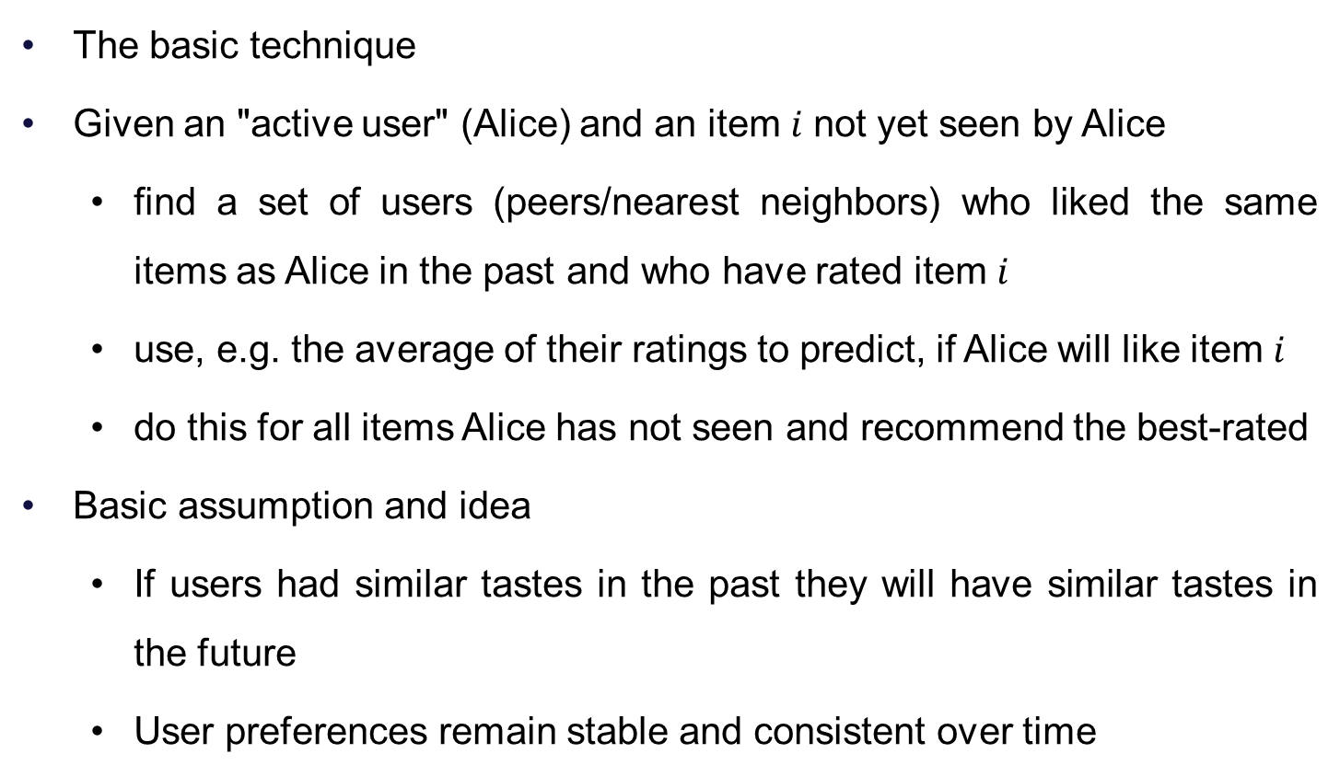
User-based nearest-neighbor collaborative filtering
4/12/2019 SS ZG537 (INFORMATION RETRIEVAL) 13
Pilani Campus

Slide 14
User-based nearest-neighbor collaborative filtering
Example
A database of ratings of the current user, Alice, and some other users is given:
Determine whether Alice will like or dislike Item5, which Alice has not yet rated or seen
 | Item1 | Item2 | Item3 | Item4 | Item5
Alice | 5 | 3 | 4 | 4 | ?
User1 | 3 | 1 | 2 | 3 | 3
User2 | 4 | 3 | 4 | 3 | 5
User3 | 3 | 3 | 1 | 5 | 4
User4 | 1 | 5 | 5 | 2 | 1
4/12/2019 SS ZG537 (INFORMATION RETRIEVAL) 14
Pilani Campus

Slide 15
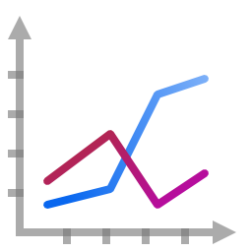
User-based nearest-neighbor collaborative filtering
Some first questions
How do we measure similarity?
How many neighbors should we consider?
How do we generate a prediction from the neighbors' ratings?
 | Item1 | Item2 | Item3 | Item4 | Item5
Alice | 5 | 3 | 4 | 4 | ?
User1 | 3 | 1 | 2 | 3 | 3
User2 | 4 | 3 | 4 | 3 | ?
User3 | 3 | 3 | 1 | 5 | 4
User4 | 1 | 5 | 5 | 2 | 1
4/12/2019 SS ZG537 (INFORMATION RETRIEVAL) 15
Pilani Campus

Slide 16
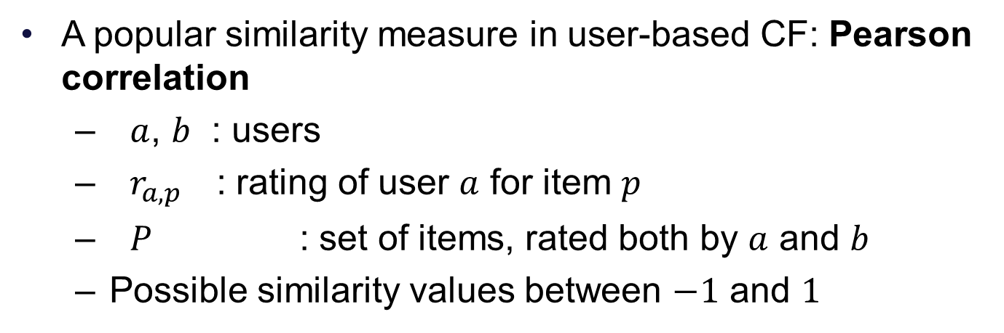
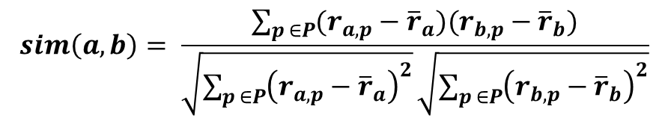
Measuring user similarity
 | Item1 | Item2 | Item3 | Item4 | Item5
Alice | 5 | 3 | 4 | 4 | ?
User1 | 3 | 1 | 2 | 3 | 3
User2 | 4 | 3 | 4 | 3 | 5
User3 | 3 | 3 | 1 | 5 | 4
User4 | 1 | 5 | 5 | 2 | 1
sim = 0,85
sim = 0,00
sim = 0,70
sim = -0,79
4/12/2019 SS ZG537 (INFORMATION RETRIEVAL) 16
Pilani Campus

Slide 17
Pearson correlation
Takes differences in rating behavior into account
Works well in usual domains, compared with alternative measures
such as cosine similarity
4/12/2019 SS ZG537 (INFORMATION RETRIEVAL) 17
Pilani Campus

Slide 18
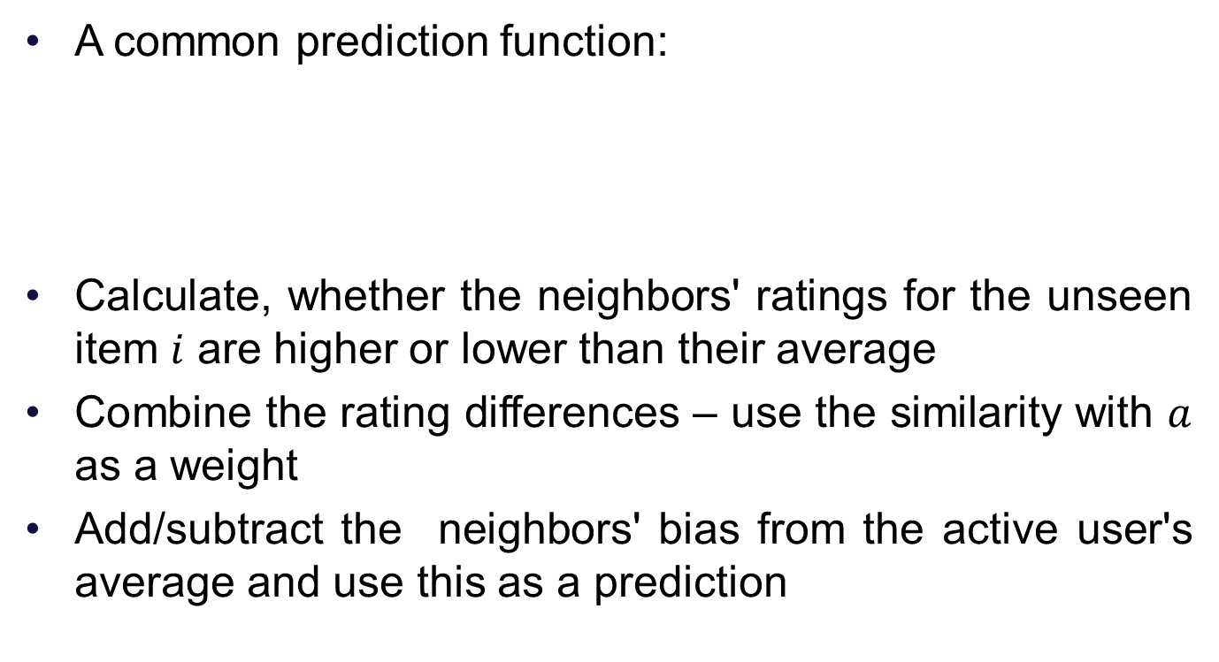
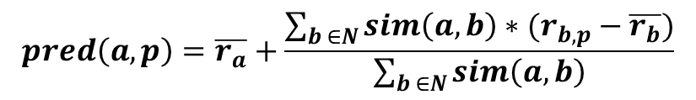
Making predictions
4/12/2019 SS ZG537 (INFORMATION RETRIEVAL) 18
Pilani Campus

Slide 19
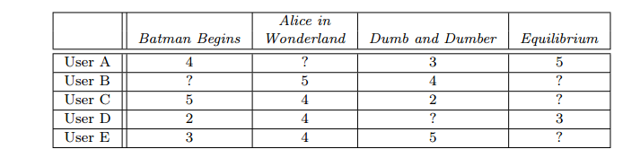
Example
Neighborhood of 2 (A and D)
C’s mean = 3.667
S(C,A) = 0.832
S(C,D)=-0.515
4/12/2019 SS ZG537 (INFORMATION RETRIEVAL) 19
Pilani Campus

Slide 20
Improving the metrics / prediction function
Not all neighbor ratings might be equally "valuable"
Agreement on commonly liked items is not so informative as agreement on controversial items
Possible solution: Give more weight to items that have a higher variance
Value of number of co-rated items
Use "significance weighting", by e.g., linearly reducing the weight when the number of co-rated items is low
Case amplification
Intuition: Give more weight to "very similar" neighbors, i.e., where the similarity value is close to 1.
Neighborhood selection
Use similarity threshold or fixed number of neighbors
4/12/2019 SS ZG537 (INFORMATION RETRIEVAL) 20
Pilani Campus

Slide 21
Item-based collaborative filtering
Basic idea:
Use the similarity between items (and not users) to make predictions
Example:
Look for items that are similar to Item5
Take Alice's ratings for these items to predict the rating for Item5
 | Item1 | Item2 | Item3 | Item4 | Item5
Alice | 5 | 3 | 4 | 4 | ?
User1 | 3 | 1 | 2 | 3 | 3
User2 | 4 | 3 | 4 | 3 | 5
User3 | 3 | 3 | 1 | 5 | 4
User4 | 1 | 5 | 5 | 2 | 1
4/12/2019 SS ZG537 (INFORMATION RETRIEVAL) 21
Pilani Campus

Slide 22
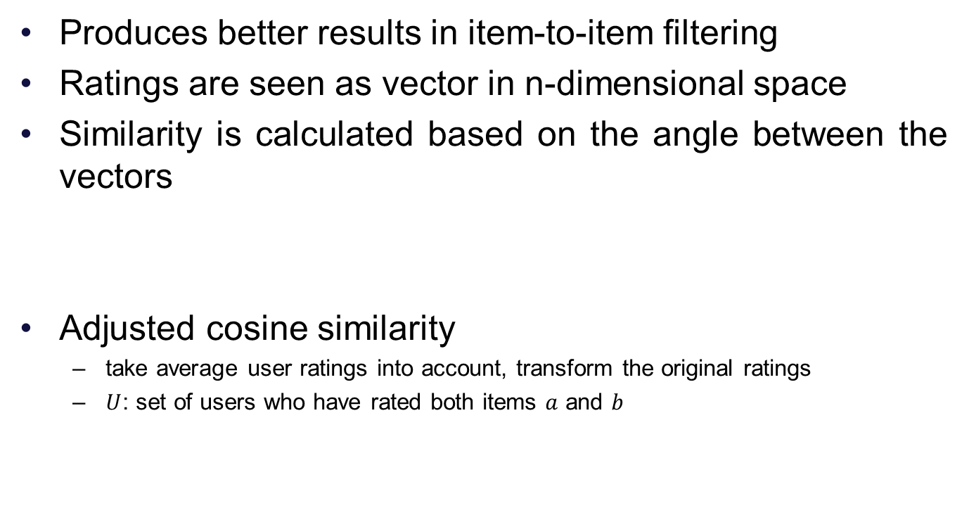
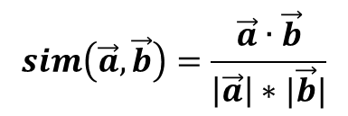
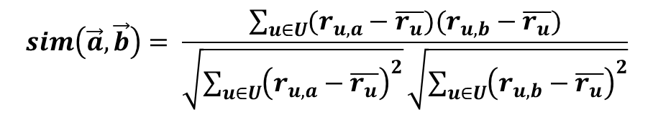
The cosine similarity measure
4/12/2019 SS ZG537 (INFORMATION RETRIEVAL) 22
Pilani Campus

Slide 23
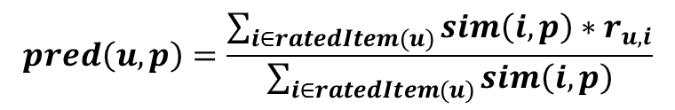
Making predictions
A common prediction function:
Neighborhood size is typically also limited to a specific size
Not all neighbors are taken into account for the prediction
An analysis of the MovieLens dataset indicates that "in most real-world situations, a neighborhood of 20 to 50 neighbors seems reasonable" (Herlocker et al. 2002)
4/12/2019 SS ZG537 (INFORMATION RETRIEVAL) 23
Pilani Campus

Slide 24

Example
Movie | L2 Norm | Cosine
b,e | 7.348 | 0.607
a,e | 8.544 | 0.174
d,e | 7.348 | 0.382
e | 5.385
2 neighbors b,d
4/12/2019 SS ZG537 (INFORMATION RETRIEVAL) 24
Pilani Campus

Slide 25
Pre-processing for item-based filtering
Item-based filtering does not solve the scalability problem itself
Pre-processing approach by Amazon.com (in 2003)
Calculate all pair-wise item similarities in advance
The neighborhood to be used at run-time is typically rather small, because only items are taken into account which the user has rated
Item similarities are supposed to be more stable than user similarities
Memory requirements
Up to N² pair-wise similarities to be memorized (N = number of items) in theory
In practice, this is significantly lower (items with no co-ratings)
Further reductions possible
Minimum threshold for co-ratings
4/12/2019 SS ZG537 (INFORMATION RETRIEVAL) 25
Pilani Campus

Slide 26
Data sparsity problems
Cold start problem
How to recommend new items? What to recommend to new users?
Straightforward approaches
Ask/force users to rate a set of items
Use another method (e.g., content-based, demographic or simply non-personalized) in the initial phase
Default voting: assign default values to items that only one of the two users to be compared has rated (Breese et al. 1998)
Alternatives
Use better algorithms (beyond nearest-neighbor approaches)
Example:
In nearest-neighbor approaches, the set of sufficiently similar neighbors might be too small to make good predictions
4/12/2019 SS ZG537 (INFORMATION RETRIEVAL) 26
Pilani Campus

Slide 27
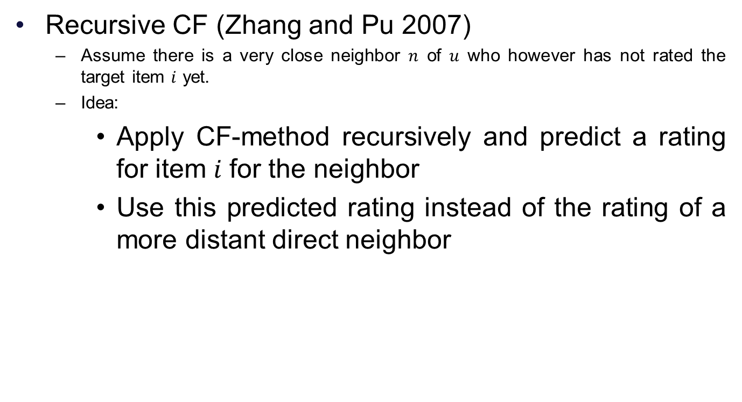
Example algorithms for sparse datasets
 | Item1 | Item2 | Item3 | Item4 | Item5
Alice | 5 | 3 | 4 | 4 | ?
User1 | 3 | 1 | 2 | 3 | ?
User2 | 4 | 3 | 4 | 3 | 5
User3 | 3 | 3 | 1 | 5 | 4
User4 | 1 | 5 | 5 | 2 | 1
sim = 0.85
Predict rating for
User1
4/12/2019 SS ZG537 (INFORMATION RETRIEVAL) 27
Pilani Campus

Slide 28
Pilani Campus
Collaborative filters using latent variables
4/12/2019 SS ZG537 (INFORMATION RETRIEVAL) 28

Slide 29
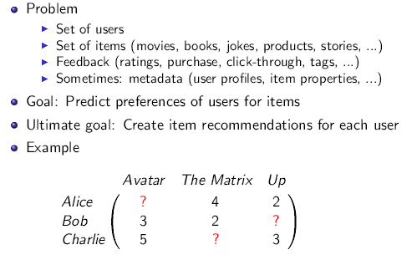
Recommender Systems
4/12/2019 SS ZG537 (INFORMATION RETRIEVAL) 29
Pilani Campus

Slide 30
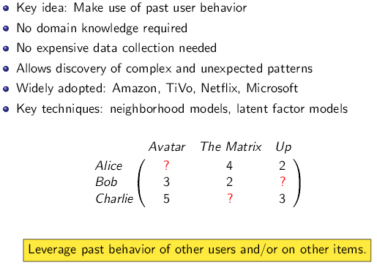
Collaborative Filtering
4/12/2019 SS ZG537 (INFORMATION RETRIEVAL) 30
Pilani Campus

Slide 31
Model based approach
The raw data are first processed offline.
At run time, only the precomputed or “learned” is required to make predictions.
4/12/2019 SS ZG537 (INFORMATION RETRIEVAL) 31
Pilani Campus

Slide 32
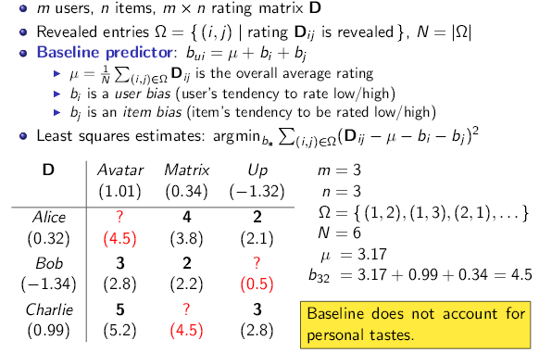
A simple baseline
4/12/2019 SS ZG537 (INFORMATION RETRIEVAL) 32
Pilani Campus

Slide 33
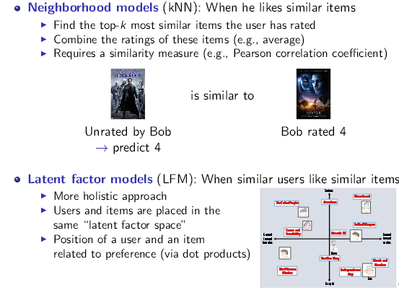
When does a user like an item?
4/12/2019 SS ZG537 (INFORMATION RETRIEVAL) 33
Pilani Campus

Slide 34
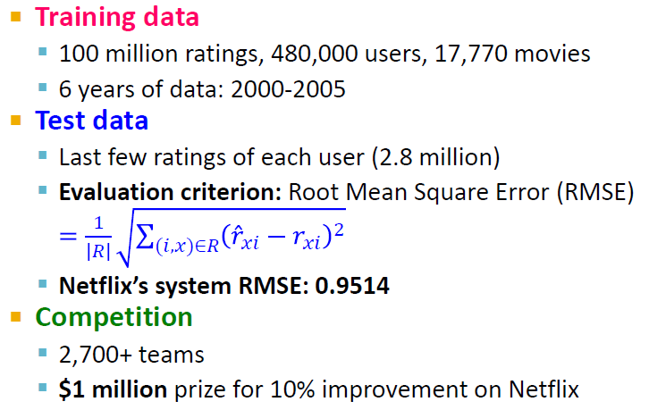
The Netflix prize
4/12/2019 SS ZG537 (INFORMATION RETRIEVAL) 34
Pilani Campus

Slide 35
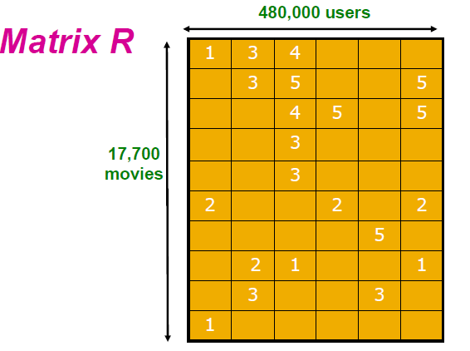
The Netflix Utility Matrix R
4/12/2019 SS ZG537 (INFORMATION RETRIEVAL) 35
Pilani Campus

Slide 36
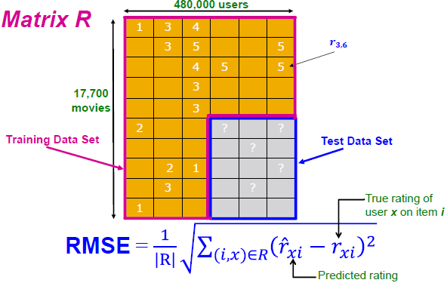
Utility Matrix R: Evaluation
4/12/2019 SS ZG537 (INFORMATION RETRIEVAL) 36
Pilani Campus

Slide 37
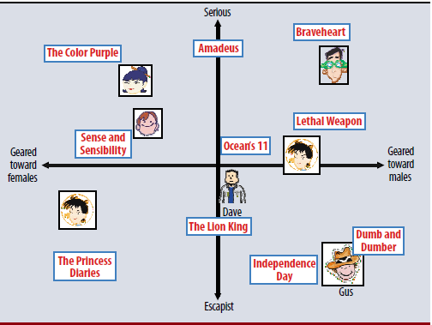
Intuition behind latent factor models
4/12/2019 SS ZG537 (INFORMATION RETRIEVAL) 37
Pilani Campus

Slide 38
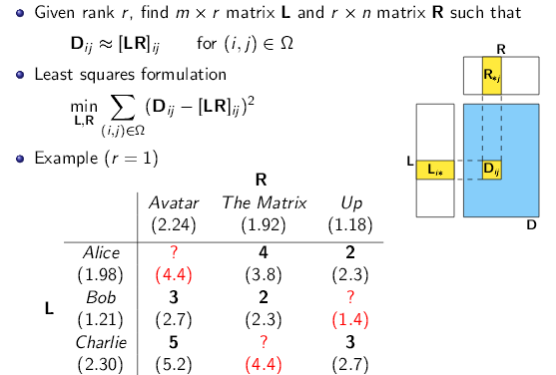
Latent factor models (simple form)
4/12/2019 SS ZG537 (INFORMATION RETRIEVAL) 38
Pilani Campus

Slide 39
Apache Prediction I/O
Apache PredictionIO is an open source Machine Learning Server built on top of a state-of-the-art open source stack for developers and data scientists to create predictive engines for any machine learning task. It lets you:
Quickly build and deploy an engine as a web service on production with customizable templates
Respond to dynamic queries in real-time once deployed as a web service
Unify data from multiple platforms in batch or in real-time for comprehensive predictive analytics
Support machine learning and data processing libraries such as Spark MLLib and OpenNLP
Speed up machine learning modeling with systematic processes and pre-built evaluation measures
4/12/2019 SS ZG537 (INFORMATION RETRIEVAL) 41
Pilani Campus

Slide 40
Take home message
Recommender systems gives you lot of surprises which you never asked for.
Most commonly used is collaborative filtering which is memory intensive.
User based collaborative filtering looks for K-Nearest neighbors and uses the predict function.
Item based collaborative filtering looks for K-Nearest Items and uses the predict function.
Issues are mainly due to cold start and data sparsity problems
4/12/2019 SS ZG537 (INFORMATION RETRIEVAL) 40
Pilani Campus

